Slide 1
NP-Complete

Slide 2
Polynomial Time ( | Exponential Time(
Linear Search----------- n Binary Search…………log n Insertion Sort------------n^2 Merge Sort-------------- n log n Matrix Chain Multiplication--------n^3 | o/1 knapsack problem----------2^n Travelling salesman Problem…………2^n Sum of Subset-----------------2^n Graph Coloring-------2^n Hamiltonian Cycle------------------2^n

Slide 3
1. If you are unable to solve those algorithms, then try to find the similarities between those algorithms. So that if one problem can be solved in polynomial time, then all other problem can be solved in polynomial time.
2. When we are unable to write the polynomial time deterministic algorithms, better to write polynomial time non deterministic algorithms for them.

Slide 4
Deterministic Algo | Non Deterministic Algo
Given a particular input, the computer will give always same output. | In this case, the computer did not understand what is the actual output.
Can solve the problem in polynomial time | Cannot solve the problem in polynomial time
0
q1
q1
0
q0
q0
1
q2
0
q2

Slide 5
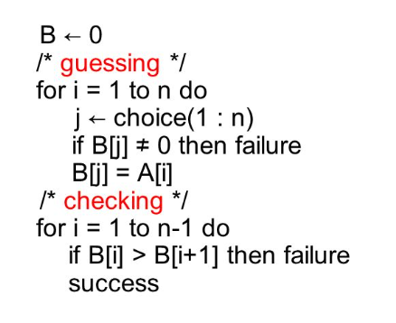
Non-Deterministic Algo

Slide 6
Can all computational problems be solved by a computer?
There are computational problems that can not be solved by algorithms even with unlimited time.
For example Turing Halting problem (Given a program and an input, whether the program will eventually halt when run with that input, or will run forever).
Alan Turing proved that general algorithm to solve the halting problem for all possible program-input pairs cannot exist.
A key part of the proof is, Turing machine was used as a mathematical definition of a computer and program

Slide 7
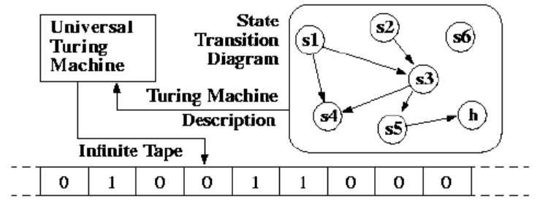
A Turing machine is a mathematical model of computation that defines an abstract machine, which manipulates symbols on a strip of tape according to a table of rules. Despite the model's simplicity, given any computer algorithm, a Turing machine capable of simulating that algorithm's logic can be constructed.

Slide 8
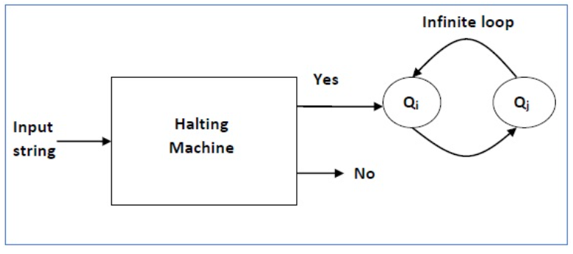
Halting MAchine

Slide 9
Status of NP Complete problems is another failure story, NP complete problems are problems whose status is unknown.
No polynomial time algorithm has yet been discovered for any NP complete problem, nor has anybody yet been able to prove that no polynomial-time algorithm exist for any of them.
The interesting part is, if any one of the NP complete problems can be solved in polynomial time, then all of them can be solved.

Slide 10
What are NP, P, NP-complete and NP-Hard problems?
P is set of problems that can be solved by a deterministic Turing machine in Polynomial time.
NP is set of decision problems that can be solved by a Non-deterministic Turing Machine in Polynomial time. P is subset of NP (any problem that can be solved by deterministic machine in polynomial time can also be solved by non-deterministic machine in polynomial time).
Informally, NP is set of decision problems which can be solved by a polynomial time via a “Lucky Algorithm”, a magical algorithm that always makes a right guess among the given set of choices

Slide 11
NP-complete problems are the hardest problems in NP set. A decision problem L is NP-complete if:
1) L is in NP (Any given solution for NP-complete problems can be verified quickly, but there is no efficient known solution).
2) Every problem in NP is reducible to L in polynomial time (Reduction is defined below).
A problem is NP-Hard if it follows property 2 mentioned above, doesn’t need to follow property 1. Therefore, NP-Complete set is also a subset of NP-Hard set.

Slide 12
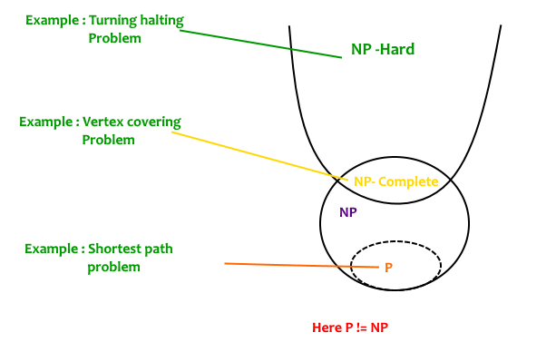

Slide 13
Decision vs Optimization Problems
NP-completeness applies to the realm of decision problems.
It was set up this way because it’s easier to compare the difficulty of decision problems than that of optimization problems.
In reality, though, being able to solve a decision problem in polynomial time will often permit us to solve the corresponding optimization problem in polynomial time (using a polynomial number of calls to the decision problem).
So, discussing the difficulty of decision problems is often really equivalent to discussing the difficulty of optimization problems.

Slide 14
For example, consider the vertex cover problem (Given a graph, find out the minimum sized vertex set that covers all edges). It is an optimization problem. Corresponding decision problem is, given undirected graph G and k, is there a vertex cover of size k?

Slide 15
What is Reduction?
Let L₁ and L₂ be two decision problems. Suppose algorithm A₂ solves L₂. That is, if y is an input for L₂ then algorithm A₂ will answer Yes or No depending upon whether y belongs to L₂ or not.
The idea is to find a transformation from L₁ to L₂ so that the algorithm A₂ can be part of an algorithm A₁ to solve L₁.

Slide 16
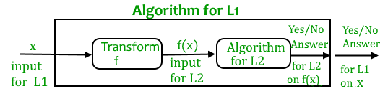

Slide 17
Learning reduction in general is very important. For example, if we have library functions to solve certain problem and if we can reduce a new problem to one of the solved problems, we save a lot of time.
Consider the example of a problem where we have to find minimum product path in a given directed graph where product of path is multiplication of weights of edges along the path.
If we have code for Dijkstra’s algorithm to find shortest path, we can take log of all weights and use Dijkstra’s algorithm to find the minimum product path rather than writing a fresh code for this new problem.

Slide 18
How to prove that a given problem is NP complete?

